Slide 1
Introduction To
System Analysis and Design
Software Analysis & Design | CSIT 5th
Instructor: Pratiksha Poudel

Slide 2
Syllabus:
The System Development Environment; Introduction, A modern approach to System Analysis and Design, Developing Information Systems, System Development Life Cycle, the heart of system development Process & the traditional Waterfall SDLC; CASE Tools.
Other Approaches: Prototyping; Spiral: Rapid Application Development; Introduction to Agile Development
Managing the Information System Project: Introduction; Managing the Information System Project; Representing & Scheduling Project Plans; Using Project Management Software

Slide 3
Introduction: Data Vs Information
Data is raw unprocessed facts and figures that have no context or purposeful meaning.
Data are raw facts about the organization and its business transactions.
Most data items have little meaning and use by themselves.
Information is processed data that has meaning and a context System and Information System.
Information is data that has been refined and organized by processing and purposeful intelligence.
3

Slide 4
Comparison
Data is used as input for the computer system. Information is the output of data.
Data is unprocessed facts figures. Information is processed data.
Data doesn’t depend on Information. Information depends on data.
Data is not specific. Information is specific.
Data is a single unit. A group of data which carries news and meaning is called Information.
Data doesn’t carry a meaning. Information must carry a logical meaning.
Data is the raw material. Information is the product.
4

Slide 5
Data Vs Information Continue…
Raw Data
Context
Processing
Information

Slide 6
System and Information System(IS)
A system is a set of related components that produces specific results.
A system is an interrelated set of business procedures used within one
business unit working together for a purpose
A system exists within an environment. A boundary separates a system from its environment.
A system has nine characteristics which are as follows:
Components
Interrelated Components
Boundary
Purpose
Environment
Interfaces
Input
Output
Constraints

Slide 7
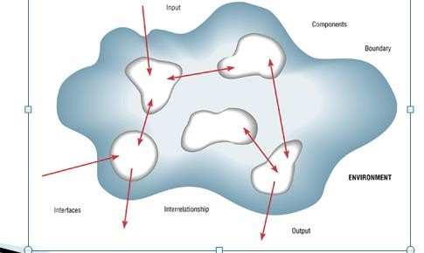
Characteristics of a System

Slide 8
System Elements
CONTROL
INPUT
PROCESS
OUTPUT
FEEDBACK

Slide 9
Information System(IS) Continue…
An information system (IS) is an arrangement of people, data, processes, communications, and information technology that interact to support and improve day-to-day operations in a business, as well as support the problem-solving and decision- making needs of management and users.
The Components of an Information System:
Input: activity of gathering and capturing raw data
Processing: converting or transforming data into useful outputs
Output: production of useful information, usually in form of documents and reports
Feedback: output used to make changes to input or processing activities.

Slide 10
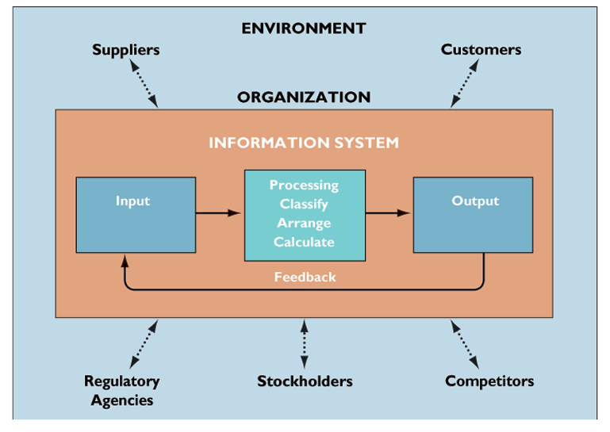
Information System(IS)
Continue…

Slide 11
1.1 The Systems Development Environment
Basic concepts of IS
System analysis and design definition
SAD: Discuss modern approach
Discuss Organizational Roles
System analyst
Information system types
SDLC :The System Development Life Cycle
CASE tools (Computer Aided Software Engineering)

Slide 12
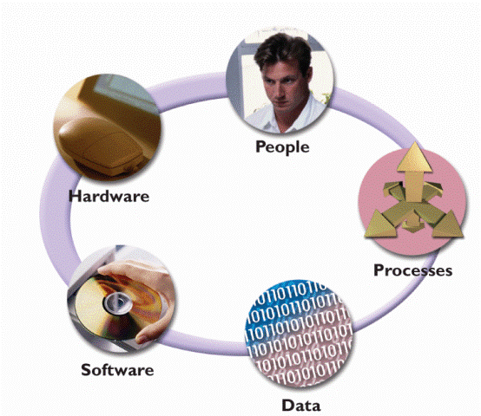
Components of Information System

Slide 13
IS Components
Hardware consists of everything in the physical layer of the information system. For example, hardware can include servers, workstations, networks, telecommunications equipment, fiber-optic cables, mobile devices, scanners, digital capture devices, and other technology-based infrastructure.
Software refers to the programs that control the hardware and produce the desired information or results.
Software consists of system software and application

Slide 14
IS Components
Data is the raw information that an information system transforms into useful information. An Information System can store data in various locations, called tables. By linking the tables, the system can extract specific information.
Processes describe the tasks and business functions that users, managers, and IT staff members perform to achieve specific results. Processes are the building blocks of an information system because they represent actual day-to-day business operations.

Slide 15
IS Components
People who have an interest in an information system are called stakeholders.
Stakeholders include the management group responsible for the system, the users (sometimes called end users) inside and outside the company who will interact with the system, and IT staff members, such as systems analysts, programmers, and network administrators who develop and support the system.

Slide 16
System analysis and design
Systems analysis and design is a step-by-step process for developing high-quality information systems.
An information system combines information technology, people, and data to support business requirements.
Systems Analysis: understanding and specifying in detail what an information system should do
System Design: specifying in detail how the parts of an information system should be implemented
Definition of SAD: The complex organizational process whereby computer-based information systems are developed and maintained.

Slide 17
System analysis and design
Introduction
Software analysis and design includes all activities, which help the transformation of requirement specification into implementation. Requirement specifications specify all functional and non-functional expectations from the software.
These requirement specifications come in the shape of human readable and understandable documents, to which a computer has nothing to do.
Software analysis and design is the intermediate stage, which helps human-readable requirements to be transformed into actual code.
Systems development is systematic process which includes phases such as planning, analysis, design, deployment, and maintenance.
19

Slide 18
System analysis and design
Analysis: defining the problem
From requirements to specification
Design: solving the problem
From specification to implementation
Modern System Analysis & Design, 4thJefferey A. Hoffer, Joey F. George and Joseph. S. Valacich, Prentice-Hall,

Slide 19
System Analysis vs. System Design
System Analysis:
Investigation of the problem and requirement rather than solution.
System Design:
A conceptual solution that fulfills the requirements, rather than implementation.

Slide 20
Systems Development Life Cycle
Systems Development Life Cycle is a systematic approach which explicitly breaks down the work into phases that are required to implement either new or modified Information System.
System Development Life Cycle (SDLC) is a conceptual model which includes policies and procedures for developing or altering systems throughout their life cycles.

Slide 21

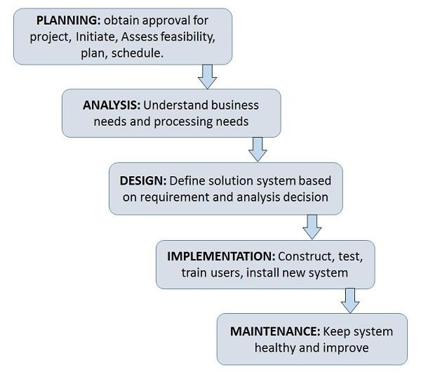
Systems Development Life Cycle( Phases of SDLC )

Slide 22
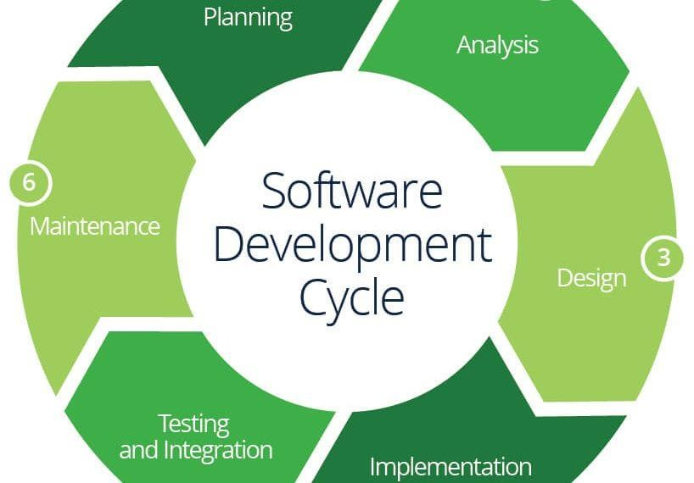
Systems Development Life Cycle( Phases of SDLC )

Slide 23
Phases of SDLC Contd….
Feasibility Study or Planning
Define the problem and scope of existing system.
Overview the new system and determine its objectives.
Confirm project feasibility and produce the project Schedule.
During this phase, threats, constraints, integration and security of system are also considered.
A feasibility report for the entire project is created at the end of this phase.

Slide 24
SDLC phases Contd…
Analysis and Specification
Gather, analyze, and validate the information.
Define the requirements and prototypes for new system.
Evaluate the alternatives and prioritize the requirements.
Examine the information needs of end-user and enhances the system goal.
A Software Requirement Specification (SRS) document, which specifies the software, hardware, functional, and network requirements of the system is prepared at the end of this phase.

Slide 25
SDLC Phases Contd…
System Design
Includes the design of application, network, databases, user interfaces, and system interfaces.
Transform the SRS document into logical structure, which contains detailed and complete set of specifications that can be implemented in a programming language.
Create a contingency, training, maintenance, and Review the proposed design
27
Notes:
Contingency: a provision for a possible event or circumstances but cannot be predicted with certainity.

Slide 26
SDLC Phases Contd…
Implementation
Implement the design into source code through coding.
Combine all the modules together into training environment that detects errors and defects.
A test report which contains errors is prepared through test plan that includes test related tasks such as test case generation, testing criteria, and resource allocation for testing.
Integrate the information system into its environment and install the new system.

Slide 27
SDLC Phases Contd..
Maintenance/Support
Include all the activities such as phone support or physical on-site
support for users that is required once the system is installing.
Implement the changes that software might undergo over a period of time, or implement any new requirements after the software is deployed at the customer location.
It also includes handling the residual errors and resolve any issues that may exist in the system even after the testing phase.
Maintenance and support may be needed for a longer time for large
systems and for a short time for smaller systems.

Slide 28
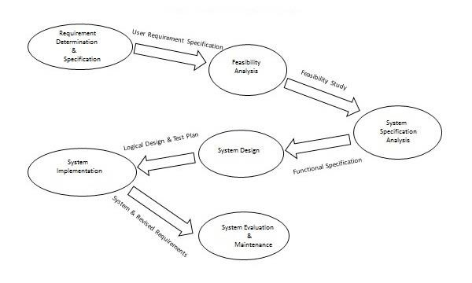
Life Cycle of System Analysis and Design

Slide 29
System analyst
The System analyst is a person who is thoroughly aware of the system and guides the system development project by giving proper directions.
He is an expert having technical and interpersonal skills to carry out development tasks required at each phase.

Slide 30
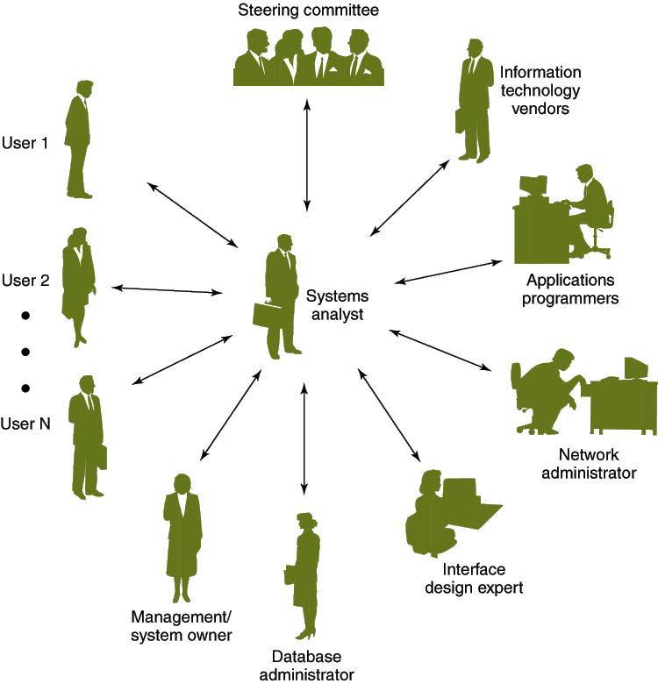
The Systems Analyst as a Facilitator

Slide 31
Skills Required by Systems Analysts
Working knowledge of information technology
Computer programming experience and expertise
General business knowledge
Problem-solving skills
Interpersonal communication skills
Interpersonal relations skills
Flexibility and adaptability
Character and ethics
Systems analysis and design skills

Slide 32
Systems Analysts
Main Roles
Defining and understanding the requirement of user through various Fact finding techniques.
Prioritizing the requirements by obtaining user consensus.
Gathering the facts or information and acquires the opinions of users.
Maintains analysis and evaluation to arrive at appropriate system which is more user friendly.

Slide 33
Systems Analysts
Main Roles
Suggests many flexible alternative solutions, pick the best solution, and quantify cost and benefits.
Draw certain specifications which are easily understood by users and programmer in precise and detailed form.
Implemented the logical design of system which must be modular.
Plan the periodicity for evaluation after it has been used for some time, and modify the system as needed.

Slide 34
Attributes of a Systems Analyst
Interpersonal Skills
Interface with users and programmer.
Facilitate groups and lead smaller teams.
Managing expectations.
Good understanding, communication, selling and teaching abilities.
Motivator having the confidence to solve queries.

Slide 35
Attributes of a Systems Analyst Contd..
Analytical Skills
System study and organizational knowledge
Problem identification, problem analysis, and problem solving
Sound commonsense
Ability to access trade-off
Curiosity to learn about new organization

Slide 36
Attributes of a Systems Analyst Contd..
Management Skills
Understand computer jargon and practices.
Resource & project management.
Change & risk management.
Understand the management functions thoroughly.

Slide 37
Attributes of a Systems Analyst Contd..
Technical Skills
Knowledge of computers and software.
Keep abreast of modern development.
Know of system design tools.
Breadth knowledge about new technologies.

Slide 38
What is an Information System?
Information system is a collection of hardware, software, infrastructure and trained personnel which are going to do easy planning to make reliable infrastructure, control, coordination between software and hardware and decision making in an organization

Slide 39



What is an Information System?
A SYSTEM THAT PROVIDES THE INFORMATION NEEDED TO
ACCOMPLISH THE ORGANIZATION’S TASKS
WHAT IS A COMPUTER BASED
INFORMATION SYSTEM?
A SYSTEM THAT USES COMPUTERS TO
PROVIDE THE NEEDED INFORMATION

Slide 40
What is an Information System?
Interrelated components working together to
Collect
Process
Store
Disseminate information
To support decision making, coordination, control, analysis and visualization in an organization

Slide 41
Information System Types
Transaction Processing Systems (TPS)
Management Information Systems (MIS)
Decision Support Systems (DSS)
Executive Support Systems(ESS)
Expert System and Artificial Intelligence (ES &AI)

Slide 42
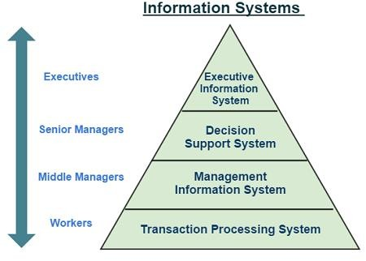
Types of IS and level of Firm

Slide 43
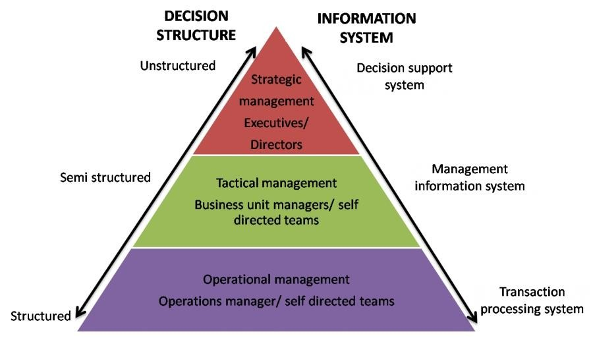
Types of IS and level of Firm

Slide 44
Transaction Processing Systems(TPS)
Computerized systems that perform and record the daily routine transactions necessary to conduct the business; they serve the organization’s operational level.
Transaction processing systems are information system applications that capture and process data about business transactions.
Includes data maintenance, which provides for custodial updates to stored data.
Business process redesign (BPR) is the study, analysis, and redesign of fundamental business (transaction) processes to reduce costs and/or improve value added to the business

Slide 45
Transaction Processing System (TPS)
TPS is a type of IS that manages data created in everyday operations. This include storing, formatting, processing, retrieving and creating some new aggregate data
some new aggregate data.
Examples: purchasing transactions, sales orders, sales transactions, payroll, employee data, inventory
Records daily, routine activities
Serves supervisory level of management

Slide 46
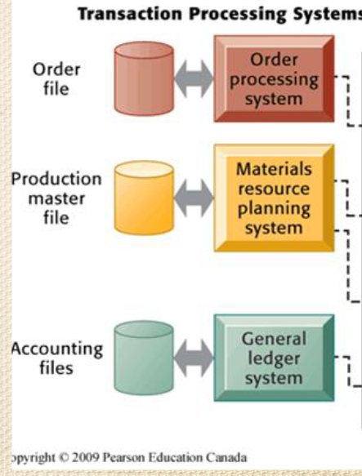
Transaction Processing System (TPS)

Slide 47
Management Information Systems(MIS)
A management information system (MIS) is an information system application that provides for management-oriented reporting. These reports are usually generated on a predetermined schedule and appear in a prearranged format.
Management information system, or MIS, broadly refers to a computer-based system that provides managers with the tools to organize, evaluate and efficiently manage departments within an organization.
Information systems at the management level of organization that serve the functions of planning, controlling, and decision making by providing routine summary and exception reports.

Slide 48
MIS Continue..
MIS convert data from internal and external sources into information for managers.
The source of data for an MIS usually comes from numerous databases. These databases are usually the data storage for Data Processing Systems.
MIS summaries and report on the organization's basic operations.
MIS produce reports for managers interested in historic trends on a regular basis.
MIS operate at the tactical level
Example: Annual budgeting
Example Annual budgeting

Slide 49
Properties of MIS
Management-oriented: The basic objective of MIS is to provide information support to the management in the organization for decision making.
Management directed: When MIS is management-oriented, it should be directed by the management because it is the management who tells their needs and requirements more effectively than anybody else.
Integrated: It means a comprehensive or complete view of all the subsystems in the organization of a company.
Common database: This is the basic feature of MIS to achieve the objective of using MIS in business organizations.

Slide 50
Properties of MIS Continue..
Computerized: MIS can be used without a computer. But the use of computers increases the effectiveness and the efficiency of the system.
User friendly/Flexibility: An MIS should be flexible.
Information as a resource: Information is the major ingredient of any MIS.
Common data flows: The integration of different subsystems will lead to a common data flow which will further help in avoiding duplicacy and redundancy in data collection, storage and processing.
Heavy planning-element: The preparation of MIS is not a one or
two day exercise. It usually takes 3 to 5 years and sometimes a much longer period

Slide 51
Decision Support System(DSS)
A decision support system (DSS) is an information system application that provides its users with decision-oriented information whenever a decision-making situation arises.
When applied to executive managers, these systems are sometimes called executive information systems (EIS).
A Decision Support System (DSS) is an interactive computer-based system or subsystem intended to help decision makers use communications technologies, data, documents, knowledge and/or models to identify and solve problems, complete decision process tasks, and make decisions.
Example: Inventory Management System

Slide 52
Decision Support System(DSS)
Decision Support System is a general term for any computer application that enhances a person or group’s ability to make decisions.
Also, Decision Support Systems refers to an academic field of research that involves designing and studying Decision Support Systems in their context of Use

Slide 53
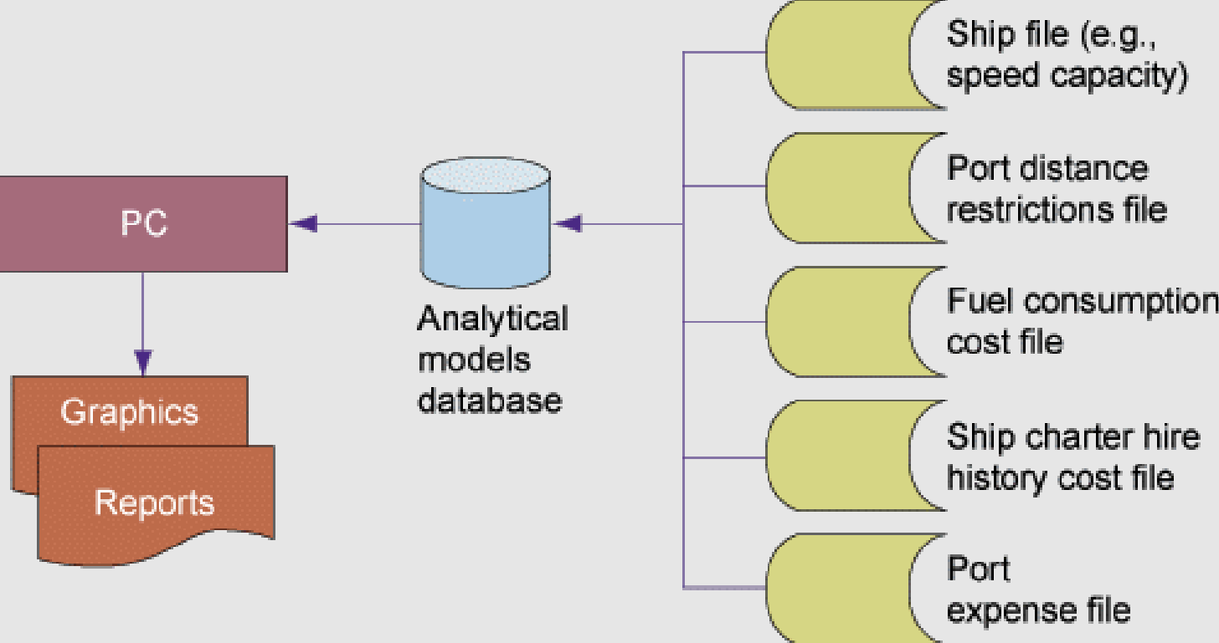
Decision support System(DSS):
Information systems at the management level of an organization that combine data and sophisticated analytical models to support non- routine decision making

Slide 54
Executive Information System
Executive Information System also known as Executive Support System (ESS) is a management support System that facilitates and supports the decision-making requirements of an organization’s senior executives.
It provides easy access to internal & external information relevant to organizational goals.
It is commonly considered as a specialized form of Decision Support System.

Slide 55
Features of EIS
Designed with Management Critical Success factor in mind.
Personalized Analysis.
Navigation of Information
Status Access, Trend Analysis, Exception Reporting
Drill Down Capabilities.

Slide 56
Expert System
An expert system is a system that employs human knowledge captured in a computer to solve problems that ordinarily require human expertise.(Turban)
An expert system is a computer program that tries to emulate human reasoning. It does this by combining the knowledge of human experts and then, following a set of rules, draws inferences.
An expert system is made up of three parts:
A knowledge base stores all of the facts, rules and information
needed to represent the knowledge of the expert.
An inference engine interprets the rules and facts to find solutions to user queries.
A user interface allows new knowledge to be entered and the system
queried.

Slide 57
Components of an Expert System
Expert System
Knowledge Base
User Interface
Inference Engine
1/21/2020
55
User

Slide 58
Expert System Advantages
Capture of scarce expertise
Superior problem solving
Reliability
Work with incomplete information
Transfer of knowledge

Slide 59
Office automation systems
Office automation (OA) systems support the wide range of business office activities that provide for improved work flow and communications between workers, regardless of whether or not those workers are located in the same office.
Personal information systems are those designed to meet the needs of a single user. They are designed to boost an individual’s productivity.
Work group information systems are those designed to meet the needs of a work group. They are designed to boost the group’s productivity.

Slide 60
System Development Lifecycle
Two main developing approaches to SDLC
Traditional approach: structured systems development and
information engineering
Object-oriented approach: object technologies requires different approach to analysis, design, and programming
Various SDLC methodologies have been developed to guide the processes involved, including the Waterfall model (which was the original SDLC method), Rapid Application Development (RAD), Joint Application development (JAD),Spiral Model and so on

Slide 61
Water fall model
The waterfall model is a sequential design process in which progress is seen as flowing steadily downwards (like a waterfall) through the phases of Conception, Initiation, Analysis, Design, Construction, Testing, Production/Implementation and Maintenance.
Waterfall approach was first SDLC Model to be used widely in Software Engineering to ensure success of the project.
In "The Waterfall“ approach, the whole process of software development is divided into separate phases.
In this Waterfall model, typically, the outcome of one phase acts as the input for the next phase sequentially

Slide 62
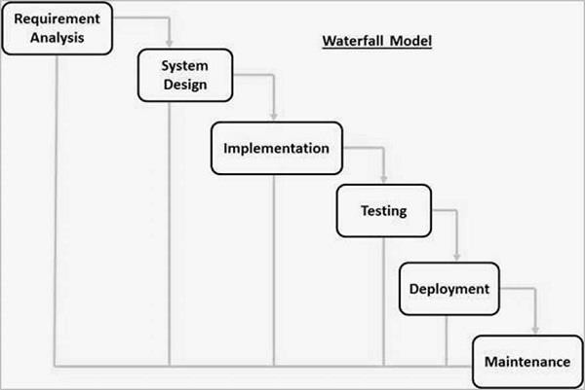
Water fall model

Slide 63
Waterfall model
Waterfall model is an example of a Sequential model. In this model, the software development activity is divided into different phases and each phase consists of series of tasks and has different objectives. Waterfall model is the pioneer of the SDLC processes.
The waterfall model is a linear, sequential approach to the software development life cycle (SDLC) that is popular in software engineering and product development. The waterfall model emphasizes a logical progression of steps.

Slide 64
Waterfall Model
Every software developed is different and requires a suitable SDLC approach to be followed based on the internal and external factors. Some situations where the use of Waterfall model is most appropriate are −
Requirements are very well documented, clear and fixed.
Product definition is stable.
Technology is understood and is not dynamic.
There are no ambiguous requirements.
Ample resources with required expertise are available to support the product.
The project is short.

Slide 65
Advantage
Some of the major advantages of the Waterfall Model are as follows −
Simple and easy to understand and use.
Easy to manage due to the rigidity of the model. Each phase has specific deliverables and a review process.
Phases are processed and completed one at a time.
Works well for smaller projects where requirements are very well understood.
Clearly defined stages.
Well understood milestones.
Easy to arrange tasks.

Slide 66
Disadvantages
No working software is produced until late during the life cycle.
High amounts of risk and uncertainty.
Not a good model for complex and object-oriented projects.
Poor model for long and ongoing projects.
Not suitable for the projects where requirements are at a moderate to high risk of changing. So, risk and uncertainty is high with this process model.
It is difficult to measure progress within stages.
Cannot accommodate changing requirements.
Integration is done as a "big-bang” at the very end, which doesn't allow identifying any technological or business bottleneck or challenges early.

Slide 67
Prototype Model
The software prototyping refers to building software application prototypes which displays the functionality of the product under development but may not actually hold the exact logic of the original software.
Software prototyping is becoming very popular as a software development model, as it enables to understand customer requirements at an early stage of development.
Prototype is a working model of software with some limited functionality.
Notes:
Prototypes: early models of a product that simulate the design and functionality.

Slide 68
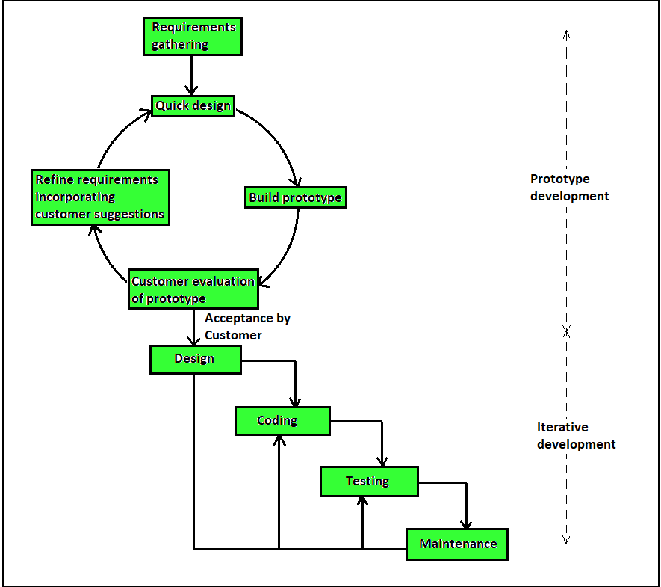
Prototyping Ctd…

Slide 69
Advantage of Prototype Model
Reduce the risk of incorrect users requirement.
Users are actively involved in the development.
Good where requirement are changing.
Errors can be detected much earlier.
Missing functionality can be identified easily.
It helps developers and users both understand the system better.

Slide 70
Disadvantages of Prototype Model
This model is costly.
It has poor documentation because of continuously changing customer requirements.
There may be too much variation in requirements.
Customers sometimes demand the actual product to be delivered soon after seeing an early prototype.
Customers may not be satisfied or interested in the product after seeing the initial prototype.
There may increase the complexity of the system.

Slide 71
Spiral Model
Spiral model is one of the most important software development life cycle, which provides support for risk handling. Also called as Boehm's Spiral Model.
Spiral model is combination of waterfall model and prototype model.
Each phase of spiral model begins with a design goal and ends with the client reviewing the progress.
The spiral model has four phases: planning, risk analysis, engineering and evaluation.
Software project repeatedly passes through these four phases in iterations (called spiral).

Slide 72
Spiral model
The spiral model is similar to the incremental model, with more emphasis placed on risk analysis. The spiral model has four phases: Planning (Identification), Risk Analysis, Development and Evaluation. A software project repeatedly passes through these phases in iterations (called spirals in this model)
Spiral model is one of the most important Software Development Life Cycle models, which provides support for Risk Handling. In its diagrammatic representation, it looks like a spiral with many loops. The exact number of loops of the spiral is unknown and can vary from project to project. Each loop of the spiral is called a Phase of the software development process.

Slide 73
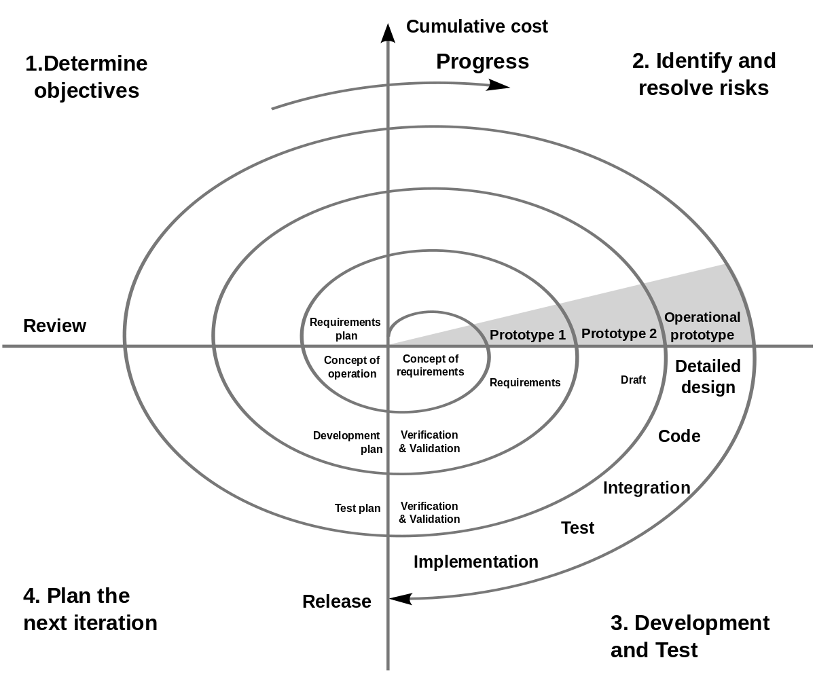
Spiral model Contd..

Slide 74
Phases of Spiral model
1. Identification
This phase starts with gathering the business requirements in the baseline spiral.
In the subsequent spirals as the product matures, identification of system requirements, subsystem requirements and unit requirements are all done in this phase.
This phase also includes understanding the system requirements by continuous communication between the customer and the system analyst. At the end of the spiral, the product is deployed in the identified market.

Slide 75
Phases of Spiral model
2. Design
The Design phase starts with the conceptual design in the baseline spiral and involves architectural design, logical design of modules, physical product design and the final design in the subsequent spirals.

Slide 76
Phases of Spiral model
3 Construct or Build
The Construct phase refers to production of the actual software product at every spiral. In the baseline spiral, when the product is just thought of and the design is being developed a POC (Proof of Concept) is developed in this phase to get customer feedback.
Then in the subsequent spirals with higher clarity on requirements and design details a working model of the software called build is produced with a version number. These builds are sent to the customer for feedback.

Slide 77
Phases of Spiral model
4.Evaluation and Risk Analysis
Risk Analysis includes identifying, estimating and monitoring the technical feasibility and management risks, such as schedule slippage and cost overrun. After testing the build, at the end of first iteration, the customer evaluates the software and provides feedback.
The following illustration is a representation of the Spiral Model, listing the activities in each phase.

Slide 78
Advantages of Spiral Model:
Risk Handling: The projects with many unknown risks that occur as the development proceeds, in that case, Spiral Model is the best development model to follow due to the risk analysis and risk handling at every phase.
Good for large projects: It is recommended to use the Spiral Model in large and complex projects.
Flexibility in Requirements: Change requests in the Requirements at later phase can be incorporated accurately by using this model.
Customer Satisfaction: Customer can see the development of the product at the early phase of the software development and thus, they habituated with the system by using it before completion of the total product.

Slide 79
Advantage of Spiral Model contd…
Additional functionality or changed can be done at a later stage.
Cost estimation becomes easy as the prototype building is done in small fragments.
Continuous or repeated development helps in risk management.
There is always a space for customer feedback and the changes are implemented faster.

Slide 80
Disadvantages of Spiral Model:
Complex: The Spiral Model is much more complex than other SDLC models.
Expensive: Spiral Model is not suitable for small projects as it is expensive.
Too much dependability on Risk Analysis: The successful completion of the project is very much dependent on Risk Analysis. Without very highly experienced experts, it is going to be a failure to develop a project using this model.
Difficulty in time management: As the number of phases is unknown at the start of the project, so time estimation is very difficult.

Slide 81
Disadvantage contd…
Risk of not meeting the schedule or budget.
Spiral Model is not suitable for small projects as it is expensive.
For its smooth operation spiral model protocol needs To be followed strictly

Slide 82
Computer-Aided Software Engineering (CASE) Tools
Computer-aided software engineering (CASE) refers to automated software tools used by systems analysts to develop information systems.
These tools can be used to automate or support activities throughout the systems development process with the objective of increasing productivity and improving the overall quality of systems
Computer-Aided Software Engineering (CASE)tools are automated

Slide 83
Computer-Aided Software Engineering (CASE) Tools
Software packages that help to automate activities in the SDLC.
CASE tools aim to enforce an engineering-type approach to the development of software systems.
CASE tools range from simple diagramming tools to very sophisticated programs to document and automate most of the stages in the SDLC.
CASE tools used since the early 1990s

Slide 84
Computer-Aided Software Engineering (CASE) Tools
The case for using CASE tools:
Improve quality of systems developed.
Help to increase the productivity of systems analysts.
Improve communication within the development team and with users.
Encourage an integrated approach to the SDLC.
Improve the management of the project.
Particularly helpful for systems maintenance

Slide 85
Types of CASE tools
There are three types of CASE tools:
Upper CASE
Support analysis and design
Lower CASE
Support programming and implementation
Integrated CASE
Combines both upper and lower CASE

Slide 86
Types of CASE tools Continue..
Upper CASE tools
Create and modify the system design.
Information about the project stored in the CASE repository (reports, diagrams, files)
Support modelling of how the system fits into the organization.
Analysis reports show incomplete parts and errors in the system design e.g. balance between process and data models.
Lower CASE Tools
Generate source code and reduce need for systems
programming.
Time for maintenance is reduced because test and debug are
eliminated.

Slide 87
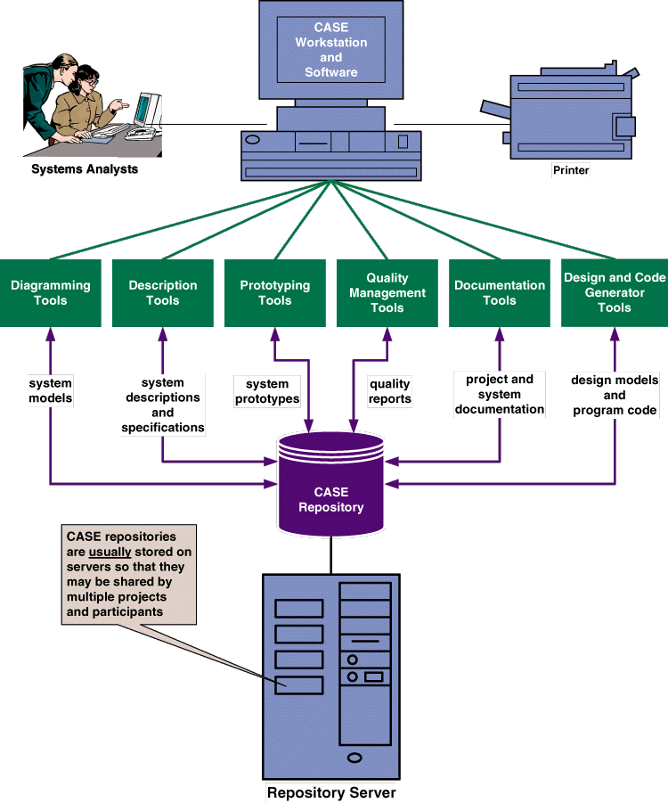
CASE repository
G.RAY
1/21/2020
82

Slide 88
CASE Tools
Examples of CASE Tools: (explore examples)
Diagramming –for representing processes, data and control structures graphically.(analysis). Lucidchart, draw.io are example of digramming case tools
CASE repository – holds information required to create, modify and evolve the system. (analysis, design, implementation)
Form and report generators – automate generation of forms and reports to aid prototyping. (design, implementation, RAD, XP)
Code generators – automate generation of source code from diagrams and forms. (design, implementation)

Slide 89
CASE Tools
Project management – aid in the planning, tracking, controlling and reporting of project management. (planning)
Document generator – create standard reports based upon the contents of the CASE repository. (analysis, design, implementation)
CASE Analysis Tools – help to identify problems of inconsistency, redundancy and omissions. (more likely in analysis and design)

Slide 90
Rapid Application Development (RAD)
RAD Model or Rapid Application Development model is a software development process based on prototyping without any specific planning.
Rapid Application development focuses on gathering customer requirements through workshops or focus groups, early testing of the prototypes by the customer using iterative concept, reuse of the existing prototypes (components), continuous integration and rapid delivery.

Slide 91
Rapid Application Development (RAD)
RAD uses a combination of Joint Application Development (JAD) techniques and CASE tools to convert user needs to designs.
In RAD model, there is less attention paid to the planning and more priority is given to the development tasks.
It targets at developing software in a short span of time.
System developers and users work together

Slide 92
Rapid Application Development (RAD)
In RAD model the components or functions are developed in parallel as if they were mini projects. The developments are time boxed, delivered and then assembled into a working prototype.
This can quickly give the customer something to see and use and to provide feedback regarding the delivery and their requirement.

Slide 93
Rapid Application Development (RAD)
RAD model enables rapid delivery as it reduces the overall development time due to the reusability of the components and parallel development.
RAD works well only if high skilled engineers are available and the customer is also committed to achieve the targeted prototype in the given time frame.
If there is commitment lacking on either side the model may fail.

Slide 94
When to use RAD Methodology?
When a system needs to be produced in a short span of time.
When the requirements are known.
When the user will be involved all through the life cycle.
When technical risk is less.
When a budget is high enough to afford designers for modeling along with the cost of automated tools for code generation like case tools

Slide 95
SDLC RAD modeling has following phases
Business Modeling
Data Modeling
Process Modeling
Application Generation
Testing and Turnover

Slide 96
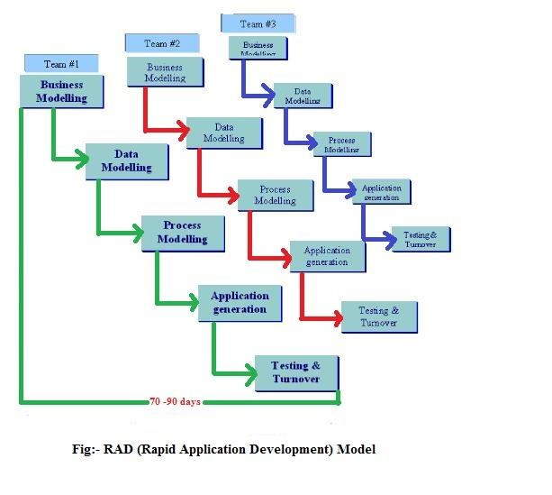
Rapid application development (RAD) Model

Slide 97
RAD Model
Business Modeling :The information flow among business functions is defined by answering questions like what information drives the business process, what information is generated, who generates it, where does the information go, who process it and so on.
Data Modeling :
The information collected from business modeling is refined into a set of data objects (entities) that are needed to support the business.
The attributes (character of each entity) are identified and the relation between these data objects (entities) is defined.

Slide 98
RAD Model
Process Modeling :
The data object defined in the data modeling phase are transformed to achieve the information flow necessary to implement a business function.
Processing descriptions are created for adding, modifying, deleting or retrieving a data object.

Slide 99
RAD Model
Application Generation :
Automated tools are used to facilitate construction of the software;
Even they use the 4th GL techniques.
The term fourth-generation programming language is better understood to be a fourth generation environment; packages of systems development software including very high level programming languages.

Slide 100
RAD Model
Testing and Turnover :
Many of the programming components have already been tested since RAD emphasis reuse.
This reduces overall testing time. But new components must be tested and all interfaces must be fully exercised.

Slide 101
Advantages of RAD | Disadvantages of RAD
Requirements can be changed at any time | Needs strong team collaboration
Encourages and priorities customer feedback | Cannot work with large teams
Reviews are quick | Needs highly skilled developers
Development time is drastically reduced | Needs user requirement throughout the life cycle of the product

Slide 102
Advantages of RAD | Disadvantages of RAD
More productivity with fewer people | Only suitable for projects which have a small development time
Time between prototypes and iterations is short | More complex to manage when compared to other models
Integration isn’t a problem, since it integrates from project inception | Only systems which can be modularised can be developed using Rapid application development.

Slide 103
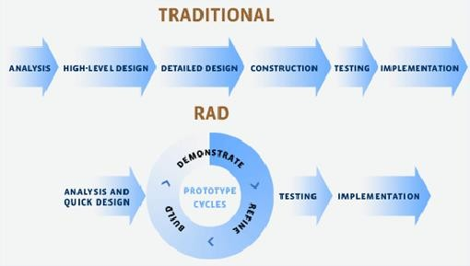
Traditional Vs RAD Diagram

Slide 104
RAD Model Vs Traditional SDLC
The traditional SDLC follows a rigid process models with high emphasis on requirement analysis and gathering before the coding starts.
It puts pressure on the customer to sign off the requirements before the project starts and the customer doesn’t get the feel of the product as there is no working build available for a long time.
The customer may need some changes after he gets to see the software. However, the change process is quite rigid and it may not be feasible to incorporate major changes in the product in the traditional SDLC.

Slide 105
RAD Model Vs Traditional SDLC
The RAD model focuses on iterative and incremental delivery of working models to the customer.
This results in rapid delivery to the customer and customer involvement during the complete development cycle of product reducing the risk of non-conformance with the actual user requirements.

Slide 106
Joint Application Design
JAD Philosophy
JAD concept is based on 4 ideas
Idea 1: The users who do the job have the best understanding of that job.
Idea 2: The developers have the best understanding of how technology works.
Idea 3: The business process and the software development process work the same basic way.
Idea 4: The best software comes out of a process that all groups work as equals and as one team with a single goal that all agree on.

Slide 107
Joint Application Design
JAD (Joint Application Development) is a methodology that involves the client or end user in the design and development of an application, through a succession of collaborative workshops called JAD sessions.
JAD is a technique that allows the developments, management, and customer groups to work together to build a product.
JAD offers a team oriented approach for the development of system. JAD team organizes meeting with the objective to get the accurate system requirements from the participant. The system analyst will collect data through discussions, asking questions, taking notes and provide support to the team.

Slide 108
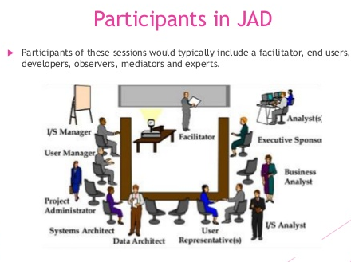

Slide 109
JAD Session
Some typical roles found in a JAD session include:
Facilitator – 1 (only one) - usually a Senior Business Analyst - facilitates discussions, enforces rules,
Scribe – 1 or 2 – sometimes more junior BAs – take meeting notes and clearly document all decisions,
End users – 3 to 5, attend all sessions,
Technical Experts – 1 or 2, question for clarity and give feedback on technical constraints,
Tie Breaker – Senior manager (executive) - breaks end user ties, usually doesn’t attend,
Subject Matter Experts,
Observers – 2 or 3 - junior BAs, testers, etc. - do not speak.

Slide 110
Joint application design (JAD) Continue..
Advantages:
Saves time
Produces higher quality systems
Easier implementation
Lower training costs
Disadvantages:
Very difficult to get all users to JAD meetings
More expensive compared to traditional method
Difficult to handle if size of team is too big for system scale

Slide 111
Agile Model
Agile SDLC model is a combination of iterative and incremental process models with focus on process adaptability and customer satisfaction by rapid delivery of working software product. Agile Methods break the product into small incremental builds. These builds are provided in iterations. Each iteration typically lasts from about one to three weeks. Every iteration involves cross functional teams working simultaneously on various areas like −
Planning
Requirements Analysis
Design
Coding
Unit Testing and
Acceptance Testing.

Slide 112
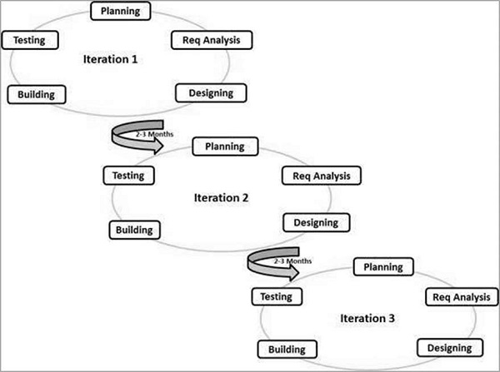
Agile Method

Slide 113
Advantage of Agile Method
Is a very realistic approach to software development.
Promotes teamwork and cross training.
Functionality can be developed rapidly.
Resource requirements are minimum.
Suitable for fixed or changing requirements
Delivers early partial working solutions.
Good model for environments that change steadily.
Little or no planning required.
Easy to manage.
Gives flexibility to developers.

Slide 114
Disadvantage of Agile Method
Not suitable for handling complex dependencies.
More risk of sustainability, maintainability and extensibility.
An overall plan, an agile leader and agile practice is a must without which it will not work.
Depends heavily on customer interaction, so if customer is not clear, team can be driven in the wrong direction.
There is a very high individual dependency, since there is minimum documentation generated.
Transfer of technology to new team members may be quite challenging due to lack of documentation.

Slide 115
Extreme Programming (XP)
XP is a lightweight, efficient, low-risk, flexible, predictable, scientific, and fun way to develop a software.
eXtreme Programming (XP) was conceived and developed to address the specific needs of software development by small teams in the face of vague and changing requirements.
Extreme Programming is one of the Agile software development methodologies. It provides values and principles to guide the team behavior. The team is expected to self-organize. Extreme Programming provides specific core practices where −
Each practice is simple and self-complete.
Combination of practices produces more complex and emergent behavior.

Slide 116
Extreme Programming (XP)
Extreme Programming involves −
Writing unit tests before programming and keeping all of the tests running at all times. The unit tests are automated and eliminates defects early, thus reducing the costs.
Starting with a simple design just enough to code the features at hand and redesigning when required.
Programming in pairs (called pair programming), with two programmers at one screen, taking turns to use the keyboard. While one of them is at the keyboard, the other constantly reviews and provides inputs.
Integrating and testing the whole system several times a day.
Putting a minimal working system into the production quickly and upgrading it whenever required.
Keeping the customer involved all the time and obtaining constant feedback.

Slide 117
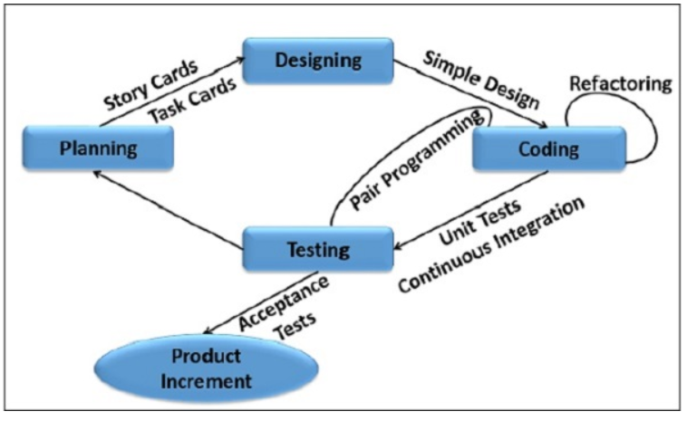
Extreme Programming (XP)
Iterating facilitates the accommodating changes as the software evolves with the changing requirements

Slide 118
Extreme Programming (XP)
Why is it called “Extreme?”
Extreme Programming takes the effective principles and practices to extreme levels.
Code reviews are effective as the code is reviewed all the time.
Testing is effective as there is continuous regression and testing.
Design is effective as everybody needs to do refactoring daily.
Integration testing is important as integrate and test several times a day.
Short iterations are effective as the planning game for release planning and iteration planning.

Slide 119
Advantage of Extreme Programming (XP)
Slipped schedules − an achievable development cycles ensure timely deliveries.
Focus on continuous customer involvement ensures transparency with the customer and immediate resolution of any issues.
Extensive and ongoing testing makes sure the changes do not break the existing functionality. A running working system always ensures sufficient time for accommodating changes such that the current operations are not affected.
Production and post-delivery defects: Emphasis is on − the unit tests to detect and fix the defects early.
Makes the customer a part of the team ensures constant communication and clarifications.
Business changes − Changes are considered to be inevitable and are accommodated at any point of time.
Staff turnover − Intensive team collaboration ensures enthusiasm and good will and reduces staff turnover.

Slide 120
Application of Extreme Programming (XP)
Some of the projects that are suitable to develop using XP model are given below:
Small projects: XP model is very useful in small projects consisting of small teams as face to face meeting is easier to achieve.
Projects involving new technology or Research projects: This type of projects face changing of requirements rapidly and technical problems. So XP model is used to complete this type of projects.

Slide 121
Service-Oriented Architecture
Service-Oriented Architecture (SOA) is an architectural approach in which applications make use of services available in the network. In this architecture, services are provided to form applications, through a communication call over the internet.
SOA allows users to combine a large number of facilities from existing services to form applications.
SOA encompasses a set of design principles that structure system development and provide means for integrating components into a coherent and decentralized system.
SOA based computing packages functionalities into a set of interoperable services, which can be integrated into different software systems belonging to separate business domains.

Slide 122
Service-Oriented Architecture
There are two major roles within Service-oriented Architecture:
Service provider: The service provider is the maintainer of the service and the organization that makes available one or more services for others to use. To advertise services, the provider can publish them in a registry, together with a service contract that specifies the nature of the service, how to use it, the requirements for the service, and the fees charged.
Service consumer: The service consumer can locate the service metadata in the registry and develop the required client components to bind and use the service.

Slide 123
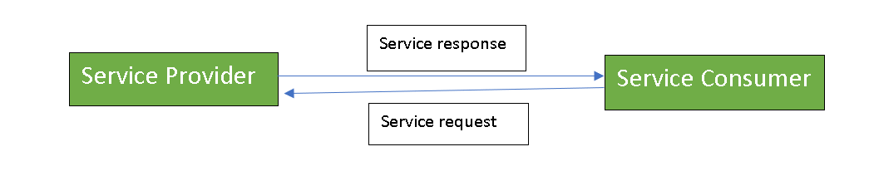
Service-Oriented Architecture
Services might aggregate information and data retrieved from other services or create workflows of services to satisfy the request of a given service consumer. This practice is known as service orchestration Another important interaction pattern is service choreography, which is the coordinated interaction of services without a single point of control.

Slide 124
Advantages of SOA:
Service reusability: In SOA, applications are made from existing services. Thus, services can be reused to make many applications.
Easy maintenance: As services are independent of each other they can be updated and modified easily without affecting other services.
Platform independent: SOA allows making a complex application by combining services picked from different sources, independent of the platform.
Availability: SOA facilities are easily available to anyone on request.
Reliability: SOA applications are more reliable because it is easy to debug small services rather than huge codes
Scalability: Services can run on different servers within an environment, this increases scalability

Slide 125
Disadvantages of SOA:
High overhead: A validation of input parameters of services is done whenever services interact this decreases performance as it increases load and response time.
High investment: A huge initial investment is required for SOA.
Complex service management: When services interact they exchange messages to tasks. the number of messages may go in millions. It becomes a cumbersome task to handle a large number of messages.

Slide 126
Object Oriented Analysis and Design
During the software development life cycle, development is typically broken up into stages, which are loose, abstract concepts used to separate the activities taking place within each phase of development. Often, these stages might include requirements, planning, design, coding/development, testing, deployment, maintenance, and so forth.

Slide 127
Object Oriented Analysis and Design
In the case of development methodologies, such as the waterfall method, these stages are sequential and intended to be completely separate from one another. Thus, when creating an application using the waterfall method, it’s unlikely that discoveries made during the testing or deployment phases can impact the decisions already made during the planning or design phases. These limitations, along with the strict step-by-step staging process of waterfall-models, led to the rise of iterative models like object-oriented analysis and design.

Slide 128
Object Oriented Analysis
Object-oriented analysis and design (OOAD) is a technological approach to analyze, design a software system or business by using Object Oriented (OO) concept.
The most important purpose of OO analysis is to identify the objects of a system that have to be implemented. This analysis can also be performed for an existing system. An efficient analysis is only possible when we think in a way where objects can be identified. After identifying the objects the relationships between them are identified and finally the design is produced.

Slide 129
Purpose of OO Analysis and Design
We can summarize the purpose of OO analysis and design in the following way:
Identifying the objects of a system
Identify their relationships
Generate a design which can be converted into applications using OO languages

Slide 130
Object Oriented Analysis
The first phase is OO analysis. In OO analysis the most important purpose is to identify objects and describes them in a proper way.
If the objects are identified efficiently then the next task of design will be easy.
The objects should be identified with their responsibilities.
The responsibilities are the functions or jobs performed by the object.
We know every object have to perform some responsibilities.
When these responsibilities are collaborated accurately the purpose of the system is fulfilled.

Slide 131
Object Oriented Design
The second phase is OO design. This phase highlights on the requirements and their fulfillment or completion.
In this phase all the objects are collaborated according to their projected relationships. After the completion of relationships the design is completed.
The third phase is OO implementation. In this phase the above design is implemented using OO languages like C#, Java, C++ etc.

Slide 132
Advantages of Object-Oriented Analysis and Design
It is easy to understand.
It is easy to maintain. Due to its maintainability OOAD is becoming more popular day by day
It provides re-usability
It reduce the development time & cost
It improves the quality of the system due to program reuse

Slide 133
Difference between Structured and Object-Oriented Analysis and Design
Structured | Object-Oriented
It is process oriented, its main focus is process. There is a separation of the systems data and processes. It breaks down the system data through the use of Data Flow Diagram (DFD) | It is data oriented, its main focus is data. There is no separation of the systems data and processes. Data and processes are encapsulated into objects It breaks down the system data through the use of Use Cases.

Slide 134
Disadvantages of Object-Oriented Analysis and Design
In OOAD, all time it is not easy to determine all the necessary classes and objects required for a system
Most of our project development teams are familiar with traditional analysis & design. The OOAD offers a new kind of project management. That’s why it may be difficult to complete a solution within estimated time and budget
Without an explicit reuse procedure this methodology do not lead to successful reuse on a large scale.

Slide 135
Disadvantages of Object-Oriented Analysis and Design
Too Complex for Simple Applications: While arguably not a disadvantage that is applicable to all projects, it’s certainly the case that OOAD practices are generally not ideal for simpler projects. Many developers have their own personal hard and fast rules to help when deciding whether a project should be procedural or object-oriented, but in most cases, the more basic the needs of the application, the more likely a less-structured, procedural approach is the best fit. As always, we must always use our own best judgment.

Slide 136
What Is Software?
Simply, software is the interface between computer systems and the humans who use them.
Software consists of programming instructions and data that tell the computer how to execute various tasks.
These days, instructions are generally written in a higher-level language, which is easier to use for human programmers, and then converted into low-level machine code that the computer can directly understand.

Slide 137
The Early Days of Software
Computer scientist Tom Kilburn is responsible for writing the world’s very first piece of software, which was run at 11 a.m. on June 21, 1948, at the University of Manchester in England.
Kilburn and his colleague Freddie Williams had built one of the earliest computers, the Manchester Small-Scale Experimental Machine (also known as the “Baby”).
The SSEM was programmed to perform mathematical calculations using machine code instructions.
This first piece of software took “only” 52 minutes to correctly compute the greatest divisor of 2 to the power of 18 (262,144).

Slide 138
The Early Days of Software
For decades after this groundbreaking event, computers were programmed with punch cards in which holes denoted specific machine code instructions.
Fortran, one of the very first higher-level programming languages, was originally published in 1957.
The next year, statistician John Tukey coined the word “software” in an article about computer programming.
Other pioneering programming languages like Cobol, BASIC, Pascal and C arrived over the next two decades.

Slide 139
The Personal Computing Era
In the 1970s and 1980s, software hit the big time with the arrival of personal computers.
Apple released the Apple II, its revolutionary product, to the public in April 1977.
VisiCalc, the first spreadsheet software for personal computing, was wildly popular and known as the Apple II’s killer app.
The software was written in specialized assembly language and appeared in 1979.

Slide 140
The Personal Computing Era
Other companies like IBM soon entered the market with computers such as the IBM PC, which first launched in 1981.
The next year, Time magazine selected the personal computer as its Man of the Year. Again, software for productivity and business dominated these early stages of personal computing.
Many significant software applications, including AutoCAD, Microsoft Word and Microsoft Excel, were released in the mid-1980s.

Slide 141
The Personal Computing Era
Open-source software, another major innovation in the history of software development, first entered the mainstream in the 1990s, driven mostly by the use of the internet.
The Linux kernel, which became the basis for the open-source Linux operating system, was released in 1991.
Interest in open-source software spiked in the late 1990s, after the 1998 publication of the source code for the Netscape Navigator browser, mainly written in C and C++.
Also noteworthy is the release of Java by Sun Microsystems in 1995.

Slide 142
The Mobile Device
The worlds very first mobile phone call was made on April 3, 1973.
In 1993 IBM released the first publicly available “smartphone” and in 1996 Palm OS hit the market, bringing PDA’s to the masses.
In 1999, RIM released the very first Blackberry 850 device and quickly became the worlds fastest growing company.
Then, in 2007, Apple changed computing with the release of the iPhone.
This is when mobile computing really found it’s place and mobile applications began to explode.
Mobile apps are now a major part of development using languages like Swift and Java.

Slide 143
Software Development Today
Today, software has become ubiquitous, even in places that you might not expect it, from crock pots to nuclear submarines.
Some programming languages, like C and Cobol, have survived the test of time and are still in use.
Other languages, such as Java and Python, are somewhat younger and have been used in countless software development projects.
Still others, such as Apple’s Swift programming language for iOS or Go Open source, are relatively new and exciting.

Slide 144
Software Acquisition
The act or process of acquiring software in different ways like purchase, download free from internet or get it bundled along with hardware is called software acquisition.
It is the way in which the software are made available to users.
Some of the ways in which the software are made available to users are as follows:

Slide 145
Software Acquisition
Retail software: It is the software sold in retail stores. It comes with printed manuals and installation instructions. For E.g. MS windows OS
Original Equipment Manufacturer (OEM) software:
It refers to software which is sold, and bundled with hardware. Microsoft sells its operating system as OEM software to hardware dealers.
OEM software is sold at reduced price, without the manuals, packaging and installation instructions.

Slide 146
Software Acquisition
Shareware: It is a program that the user is allowed to try for free, for a specified period of time, as defined in the license. It is downloadable from the Internet. When the trial period ends, the software must be purchased or uninstalled.
Freeware: It is software that is free for personal use. It is downloadable from the Internet. The commercial use of this software may require a paid license. The author of the freeware software is the owner of the software, though others may use it for free. The users abide by the license terms, where the user cannot make changes to it, or sell it to someone else.

Slide 147
Software Acquisition
Open source software: It is software whose source code is available and can be customized and altered within the specified guidelines laid down by the creator. Unlike public domain software, open-source software has restrictions on their use and modification, redistribution limitations, and copyrights. Linux, Apache, Firefox, OpenOffice are some examples of open-source software.

Slide 148
Software Acquisition
Public Domain Software: It is free software. Unlike freeware, public domain software does not have a copyright owner or license restrictions. The source code is publicly available for anyone to use. Public domain software can be modified by the user.
Demo Software: It is designed to demonstrate what a purchased version of the software is capable of doing and provides a restricted set of features. To use the software, the user must buy a fully- functional version.

Slide 149
Software Acquisition Process
Selecting software and putting it into operation presents virtually identical problems at all levels of an organization, whether that level is the organization as a whole, the office, the department, the section or the individual.
The process may be divided into four stages:
Identify the need and define the job to be done.
Formulate software acquisition strategies.
Select the optimal software and put it into operation.
Monitor the efficiency of the software selected and decide about its maintenance and updating.

Slide 150
Software Reuse & Types of Software Reuse
Software Reuse is the process of implementing or updating software systems using existing software components
Software Reuse is the use of existing software or software knowledge to build new software for an individual or an organization.
Software reuse is also called as “Code Reuse”.
Example of software reuse is software library.
Types:
Application System Reuse: It involves the reuse of entire application either by configuring a system for an environment or by integrating two or more systems to create a new application.
Component Reuse: it involves the reuse of components of one or more application in another new application.

Slide 151
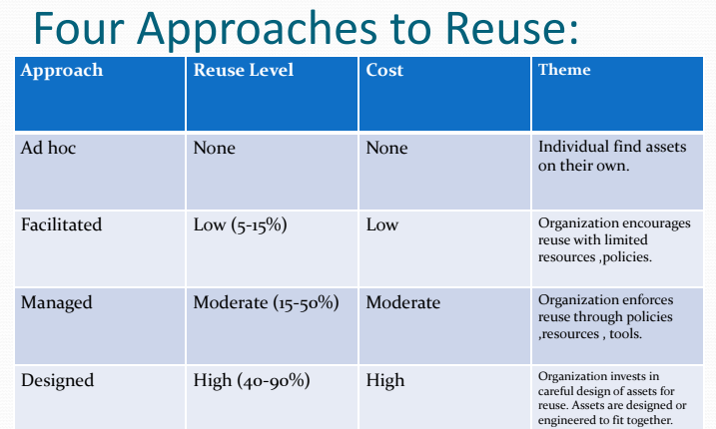

Slide 152
Benefits and Drawbacks of Software Reuse
Benefits
Produces less buggy code.
Produces high quality and standardized products.
Shorten software development time.
Reduces development and maintenance costs.
Saves organization’s time and valuable resources.
Drawbacks
Costly for developing reusable components.
Performance issues: Generic components may be incompatible and may have longer execution time.
Reused code/ design may not match with new requirements.

Slide 153
Barriers to making software available for reuse
Increased maintenance cost
Lack of tool Support how ??
Lack of knowledge

Slide 154
Managing the information system project
Project management is an important aspect of system analyst –
Need to know project management skills more details about resources management, project management, change management, risk management etc.
Project manager refers to system analyst’s role in managing information system project
Project manager works in an environment of change
S/He identifies and solves problems
S/He is responsible of all aspect of system development project (time, cost, progress, etc.)
S/He is responsible either as a part or the whole project
System analyst has specific tasks (identify requirements, allocate budget and keep timing constraints)

Slide 155
Project Management
Project manager is an individual with a diverse set of skills who is responsible for managing the project process when the project is accepted.
Responsibilities of project manager include: initiating, planning, executing and closing-down the project
Skills of project manager:
Leadership
Management (resources, materials, funding)
Customer relationships
Technical problem solving
Conflict management
Team management & risk management
Skills needed by a project manager go beyond just building a system

Slide 156
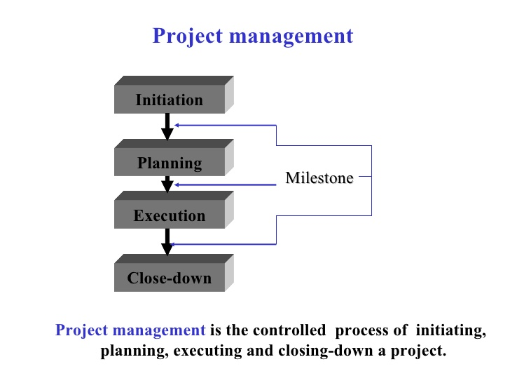
Project Management

Slide 157
Managing the Information Systems Project
Focus of project management
To ensure that information system projects meet customer expectations
Delivered in a timely manner
Meet time constraints and requirements

Slide 158
Project scheduling
In project management, a schedule is a listing of a project milestone activities, deliverables, usually intended start and finish dates.
Before a project schedule can be created the schedule maker should have a WORK BREAKDOWN STRUCTURE (WBS) an effort estimate for each task and resource list with available resource.

Slide 159
WORK BREAKDOWN STRUCTURE (WBS)
Dividing complex projects to simpler and manageable tasks is the process identified as WORK BREAKDOWN STRUCTURE (WBS).
Usually, the project managers use this method for simplifying the project execution. In WBS, much larger tasks are broken-down to manageable chunks of work. These chunks can be easily supervised and estimated.
Further sub dividing can be said as Decomposition.

Slide 160
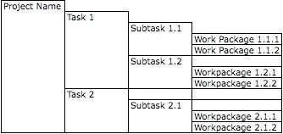
WORK BREAKDOWN STRUCTURE (WBS)

Slide 161
Types of Work BreakDown Structure
Activity-based approach
Product-based approach
Hybrid approach
In the activity-based approach, all the activities are listed and created for the project.
The product-based approach produces a product breakdown structure along with a product flow diagram. A product based structure is very much similar to the work breakdown structure which includes dividing a complex and big scale product into its sub set products until simple, manageable, independent and smaller products are obtained at the leaf level.
WBS deals with list of final deliverables whereas PBS deals in producing the products using the product flow diagram. Hybrid approach combines both the activity-based and product-based approach to structure both activities and products.

Slide 162
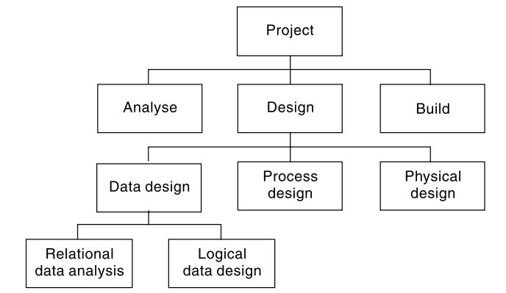
Activity Based approach

Slide 163
SCHEDULING TOOLS OR TECHNIQUES
MOST COMMONLY USED METHODS ARE:
GANTT CHART
NETWORK DIAGRAMS(PERT/CPM)

Slide 164
Gantt Chart
A Gantt chart, commonly used in project management, is one of the most popular and useful ways of showing activities (tasks or events) displayed against time.
On the left of the chart is a list of the activities and along the top is a suitable time scale. Each activity is represented by a bar; the position and length of the bar reflects the start date, duration and end date of the activity.

Slide 165
Gantt Chart
Gantt charts are used as a tool to monitor and control the project progress. Developed in 1918 by H.L. Gantt
A Gantt chart is a graphical presentation that displays activities as follows:
Time is measured on the horizontal axis. A horizontal bar is drawn proportionately to an activity’ s expected completion time.
Each activity is listed on the vertical axis.
In an earliest time Gantt chart each bar begins and ends at the earliest start finish the activity can take place.

Slide 166
APPLICATION OF GANTT CHART
Gantt chart can be used as a visual aid for tracking the progress of project activities.
Appropriate percentage of a bar is shaded to document the completed work.
The manager can easily see if the project is progressing on schedule (with respect to the earliest possible completion times).

Slide 167
Advantages and disadvantages of Gantt chart
Advantages.
Easy to construct
Gives earliest completion date.
Provides a schedule of earliest possible start and finish times of activities.
Disadvantages
Gives only one possible schedule (earliest).
Does not show whether the project is behind schedule.
Does not demonstrate the effects of delays in any one activity on the start of another activity, thus on the project completion time.

Slide 168
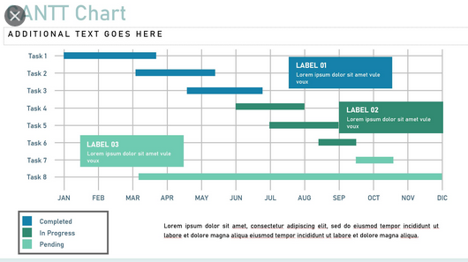
An example of Gantt chart

Slide 169
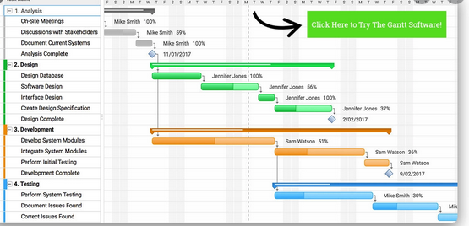
Gantt chart of Software Development

Slide 170
Project Management Information Systems
A Project Management Information System (PMIS) is one or more software tools used for a project’s information storage and distribution.
A Project Information Management System (PIMS) is the systematic process of creating, identifying, collecting, organizing, sharing, adapting, and using project information
Information management is a process for identifying all the information the project stakeholders need to make informed decisions.

Slide 171
Project Management Information Systems
PIMS is not only about technology, but the processes and procedures required to ensure the project manager is able to get the right information and make it available to the right people at the right time.
The management of project information is a critical element and a key responsibility of the project manager, as it informs, educates, guides, and builds support for the project.

Slide 172
Project Management Information Systems
Project Management Information System serves five principal purposes:
Provide information for decision-making.
Improve project management.
Demonstrate results through project evaluation.
Empower communities and other project stakeholders.
Increase opportunities to learn from experience.

Slide 173
Project Management Software
Project Management Software is software used by a wide range of industries for project planning, resource allocation and scheduling.
It enables project managers as well as entire teams to control their budget, quality management and all documentation exchanged throughout a project.
This software also serves as a platform for facilitating collaboration among project stakeholders.

Slide 174
Benefits Of Project Management Software
Overall, project management software benefits businesses by tracking the progress of projects, campaigns, resources, allocation, and tasks across an organization.
With a project management software, project managers and team operations leads can better understand how organizations and teams are pacing, and help keep teams on the same page.

Slide 175
Some Project Management Software Programs
Hive is a comprehensive, all-in-one project and campaign management tool .Hive takes project management to the next level with native chat, native email, over 1,000 integrations and flexible project views, which include Gantt, Kanban, calendar, portfolio and table view.
Trello is a great option for small teams or individuals looking to utilize a simple project management tool. The tool is Kanban board-based, which is a project management methodology started by an industrial engineer in the 40s. Cards are the basics of Trello, which you can organize into different phases on the board.

Slide 176
Some Project Management Software Programs
Asana is a user-friendly project management tool that can easily manage small and larger projects, which is why it’s part of our list of best project management softwares. The software is designed around tasks and subtasks arranged into different sections that can be assigned to either an individual or teams
Basecamp is a cloud-based tool with lots of features for individuals, project managers or even marketing teams that enables collaboration on tasks. Some of the features include to-do lists for tasks, which can be assigned to different users, and tasks that the system will automatically follow up on when the due date lapses.

Slide 177
Any Queries !!!
Thank you

